Slide 1

Company Profile

Slide 2

• Transportation Planning & Traffic Studies | • Landscape, Lagoons & Swimming Pools
• Highway & Traffic Signal Design | • MEP Design
• Infrastructure Design | • Design Verification
• Bridge & Tunnel Design | • Value Engineering
• Traffic Diversion Plans | • BIM management
• iRAP Road Safety Assessments | • Site Supervision
• Project Management | • Waste Management
• Geotechnical Engineering
Web site: www.fassiela.ae email: support@fasseila.ae

Slide 3

INTRODUCTION
FASSIELA ENGINEERING is an engineering consultancy that offers sustainable-low-cost transportation, infrastructure, Landscape, Lagoons, Swimming Pools, Waste management & MEP engineering services for the Middle East and Africa (MEA) region. The company’s name FASSIELA in Arabic means the “baby Palm Tree” and was selected to reflect a high commitment to Sustainability.
FASSIELA is considered an “engineering workshop” that provides superior quality yet cost-effective engineering solution for the entire region.
FASSIELA’S HQ is in Dubai, UAE and has a branch office in Cairo, Egypt

Slide 4
General Manager’s Int’l Message
( إِنْ قَامَتْ عَلَى أَحَدِكُمُ الْقِيَامَةُ، وَفِي يَدِهِ فَسِيلَةٌ فَلْيَغْرِسْهَا )
Profit Mohamed (PBUH) Said: If it is the last few moments for you on earth and you have in your hand a “baby palm tree” you must plant it.
Although this quote by Profit Mohamed (PBUH) has always been used by Muslim scholars in the context of encouraging people to work hard until the last minute of their lives which is absolutely true, in our opinion, there are no better words that can reflect enthusiasm about the modern notion of “Sustainability” than those words.
Being so passionate about Sustainability since voices have gone loud worldwide about climate change and the urgency that we humans should change the way we do things in order to avoid the foreseen catastrophic consequences, I have pursued a sustainable engineering credential in the field of transportation which is Sustainable Engineering Professional “STP” from the Greenroads Foundation, USA and I completed my MBA focusing on Sustainable Business Practices from the University of Cumbria, UK.

Slide 5

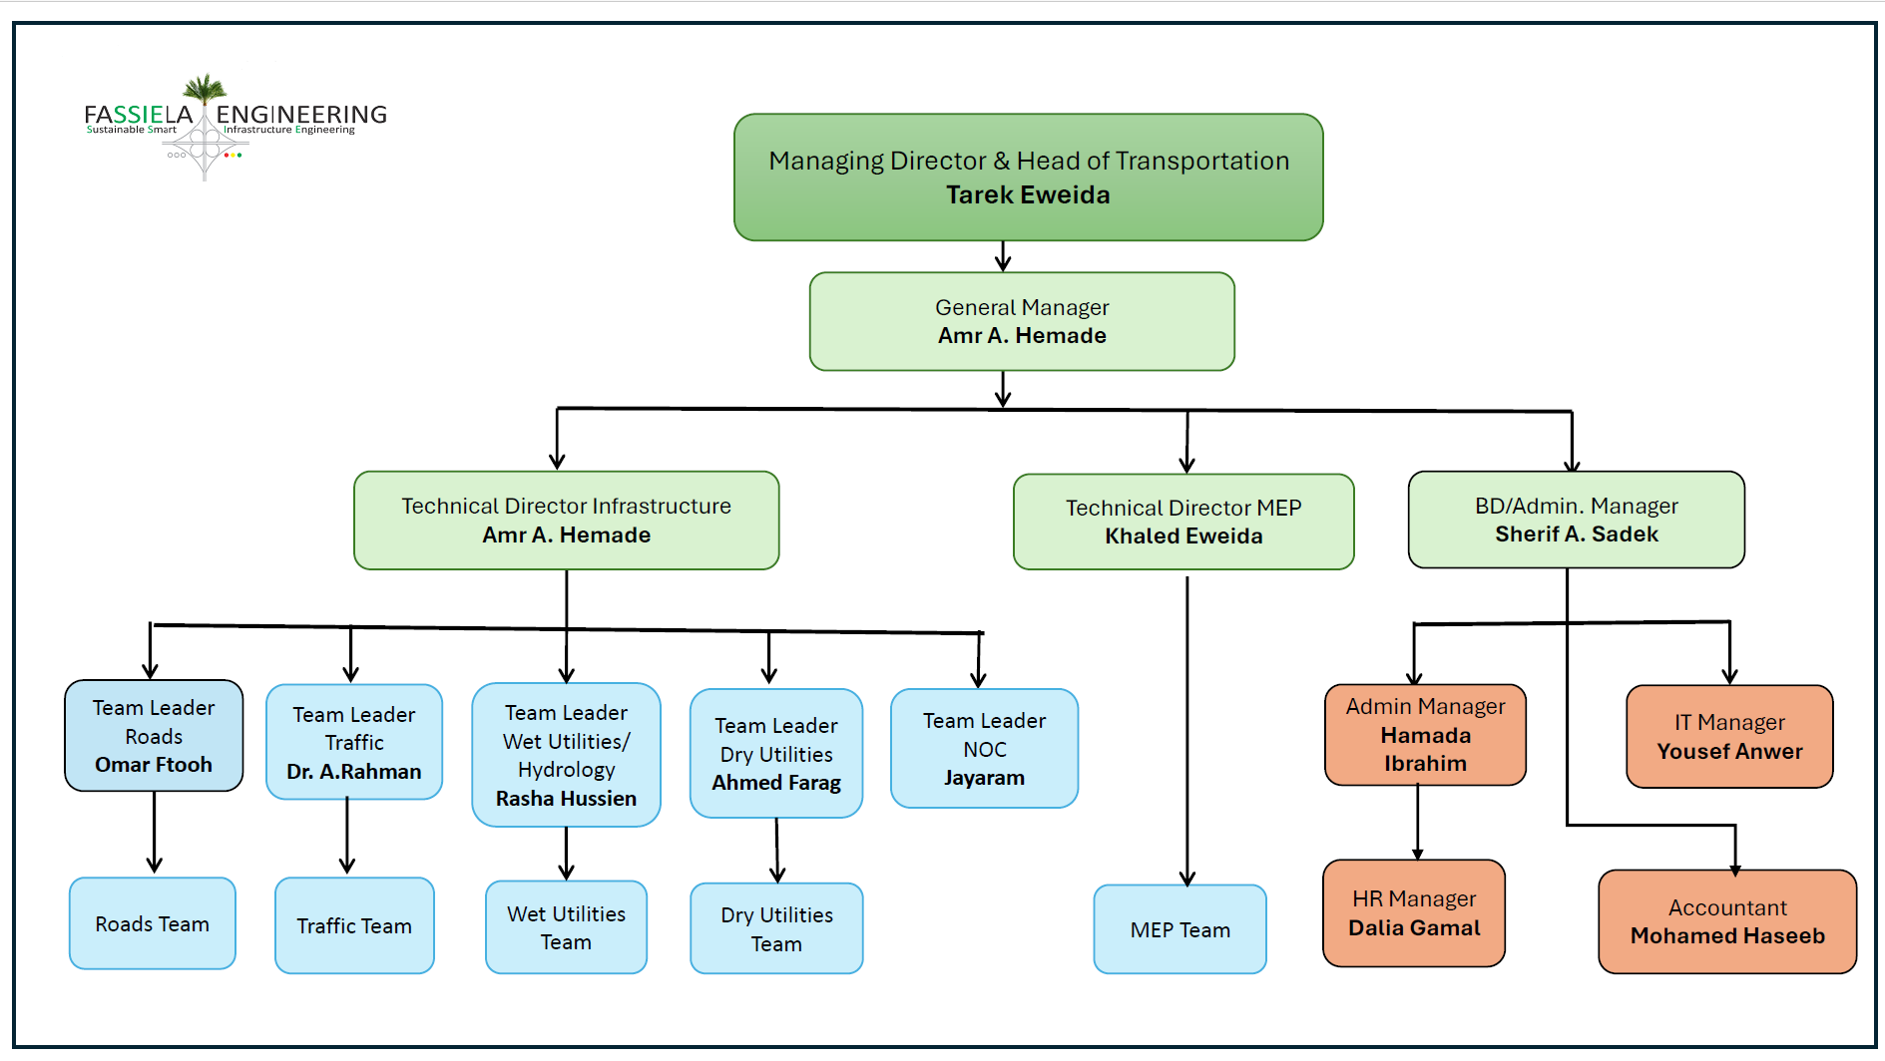
FASSIELA’S Org. Chart

Slide 6
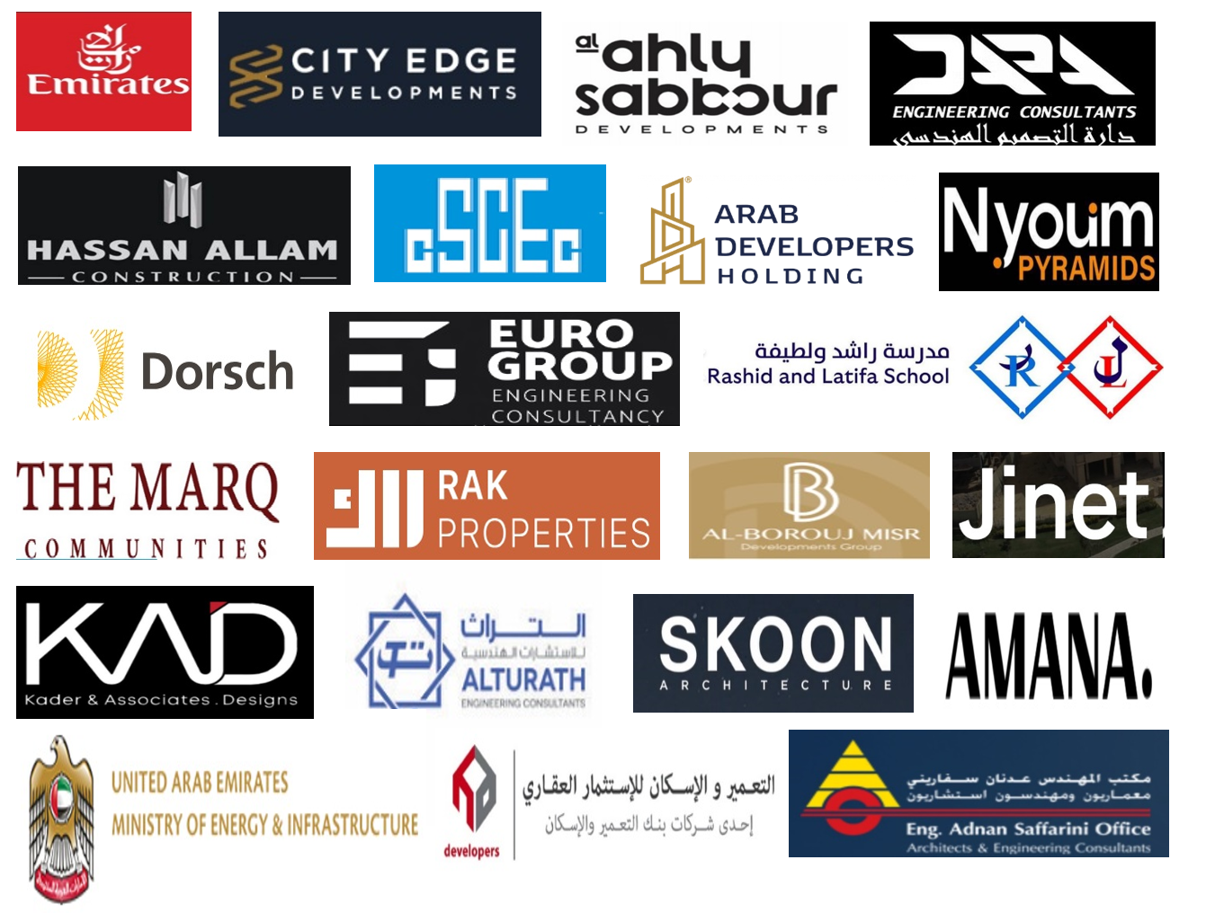
Our Clients

Slide 7
Our Registration/
Projects

Slide 8
UAE

Slide 9
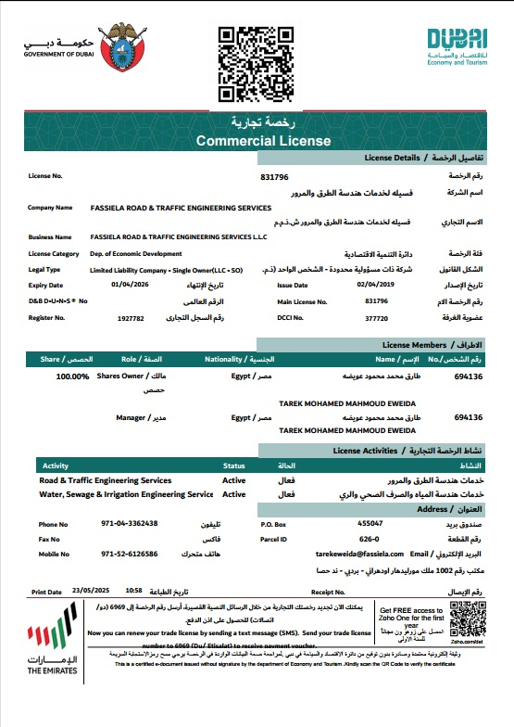
Dubai Registration

Slide 10
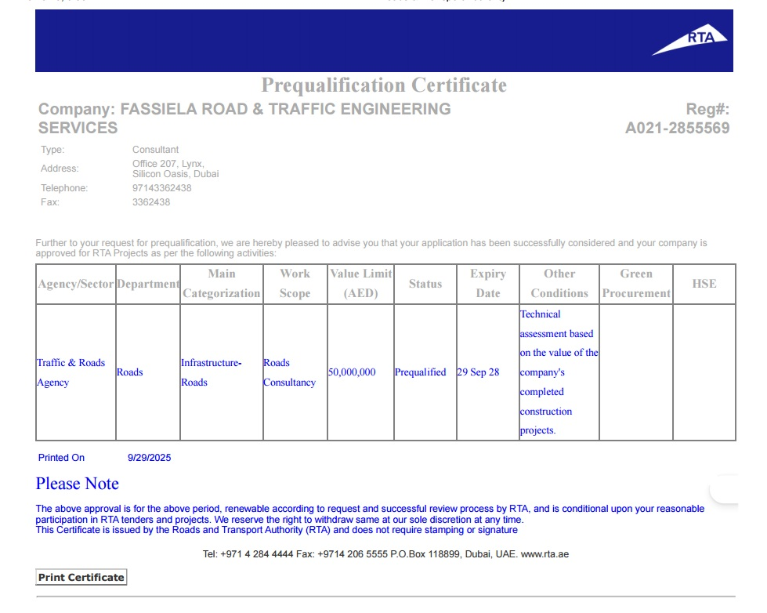

Slide 11
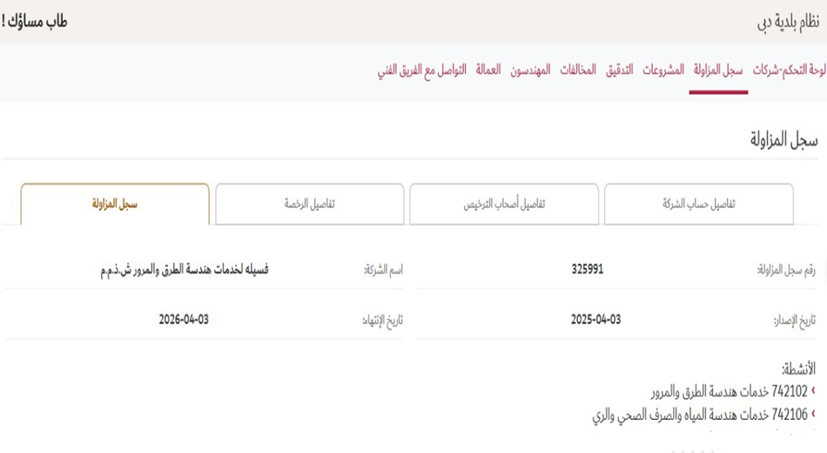

Slide 12
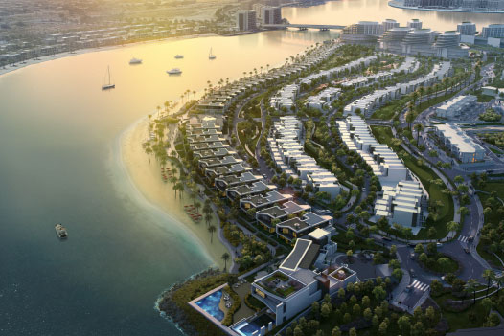
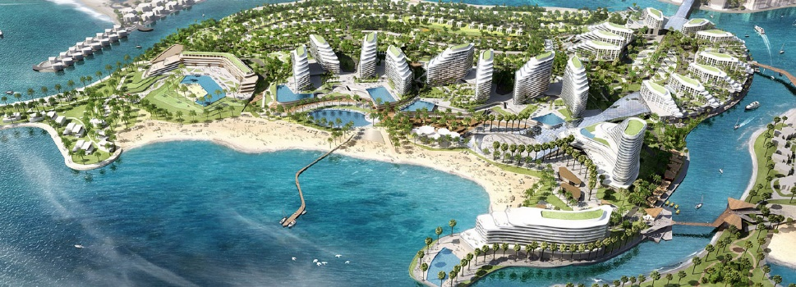
KEY PROJECTS - UAE
Project Name
Hayat Island- Ras Al-Khaimah, UAE
Project Overview
Luxurious artificial island with residential units overlooking a private beach located in Mina Al Arab Area, Ras Al Khaimah, UAE.
FASSIELA scope of work
Design of Roads and Infrastructure
Prepare the drawings and other documents requirements per RAK Municipality Requirements for NOC.

Slide 13
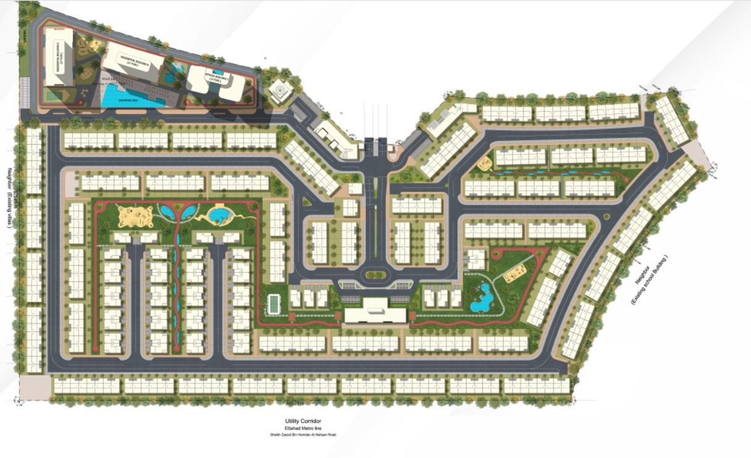
KEY PROJECTS - UAE
Project Name
Wadi El Safa
Project Overview
Luxurious Residential compound located in Wadi El Safa- Dubai
FASSIELA scope of work
Design for All Infrastructure Networks

Slide 14
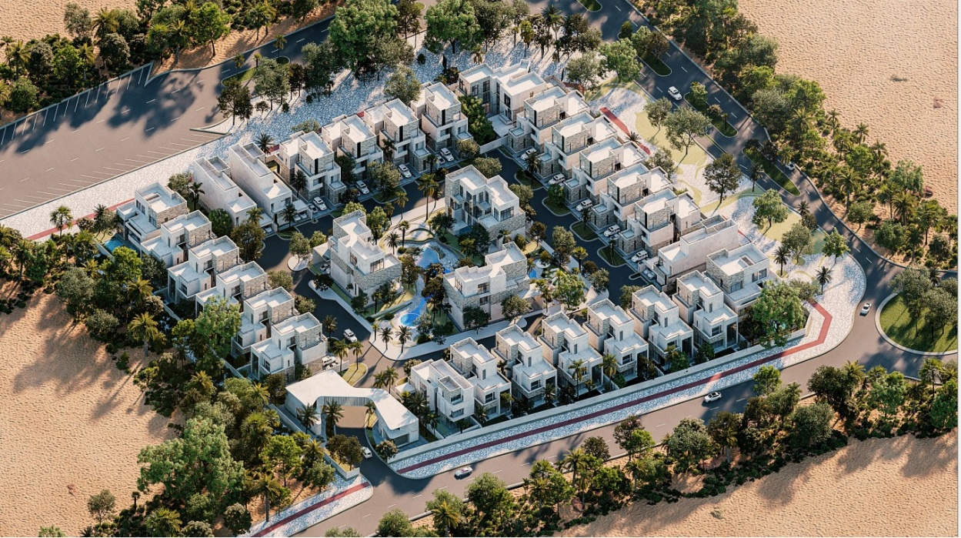
KEY PROJECTS- UAE
Project Name
Swank E-001 NAD AL Shiba
Project Overview
Luxurious Residential compound located in NAD AL Shiba- Dubai
FASSIELA scope of work
Design for All Infrastructure Networks

Slide 15
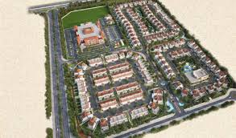
KEY PROJECTS - UAE
Project Name
Paradise Hills, Dubai, UAE.
Project Overview
Paradise Hills is a vibrant community spanning over an area of 0.18 million sqm, having 170 elegantly designed villas and townhouses.
Located on Sheikh Zayed Bin Hamdan street; Paradise Hills is close to key locations in Dubai with its spectacular highway.
FASSIELA scope of work
Design of roads and fire network, water supply network, sewage network, stormwater network, electrical MV/LV networks, & irrigation network.

Slide 16
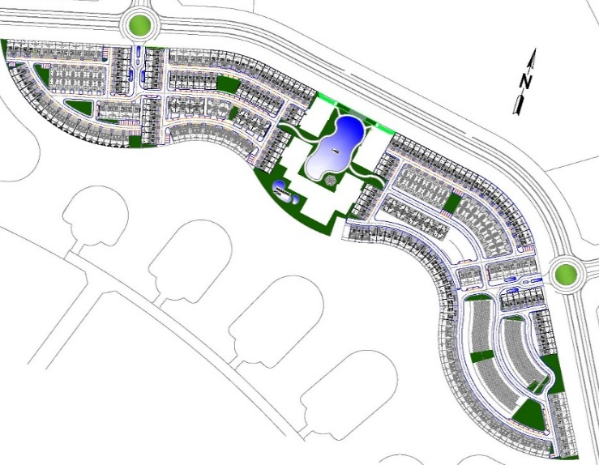
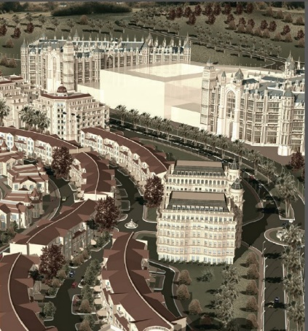
KEY PROJECTS - UAE
Project Name
Royal Estates Residential Development, Dubai Investment Park, Dubai, UAE.
Project Overview
The Royal Estates Residential Development is a residential development planned to include 37 villas and 139 Townhouses.
FASSIELA scope of work
Design of Infrastructure Including: Adjustment to RTA Roads, Parking & Villa Entrances, Fire Network, Water Supply Network, Gas Network, Electrical MV/LV Networks. Fassiela Also prepared the shop Drawings for construction.

Slide 17
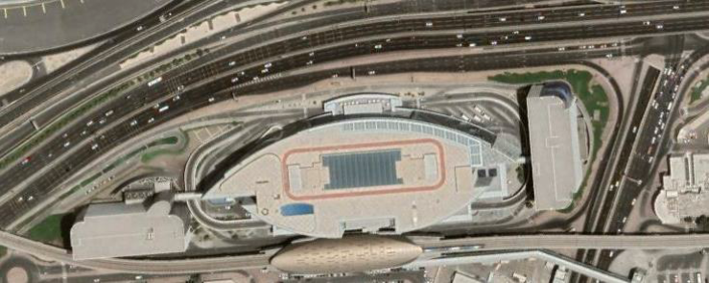
KEY PROJECTS - UAE
Project Name
Emirates HQ - Dubai, UAE
Project Overview
Office Building with total area 403015 sqm (G+14 floors) located in Al Garhoud, Dubai, UAE
FASSIELA scope of work
Re-design a stormwater system
Complementing the system that connects to DM network
Prepare the drawings and other documents requirements for RTA & DM
Coordination with RTA/DM Authorities for final approval

Slide 18
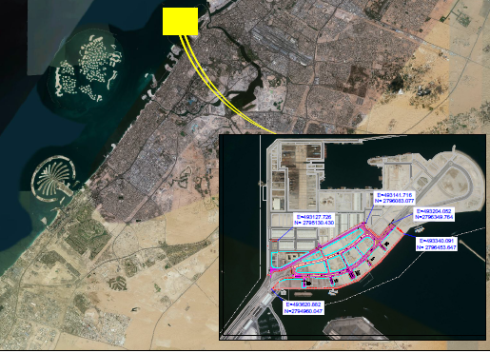
KEY PROJECTS - UAE
Project Name
Dubai Maritime City Phase 1, Dubai, UAE.
Project Overview
Mixed Use Development

Slide 19
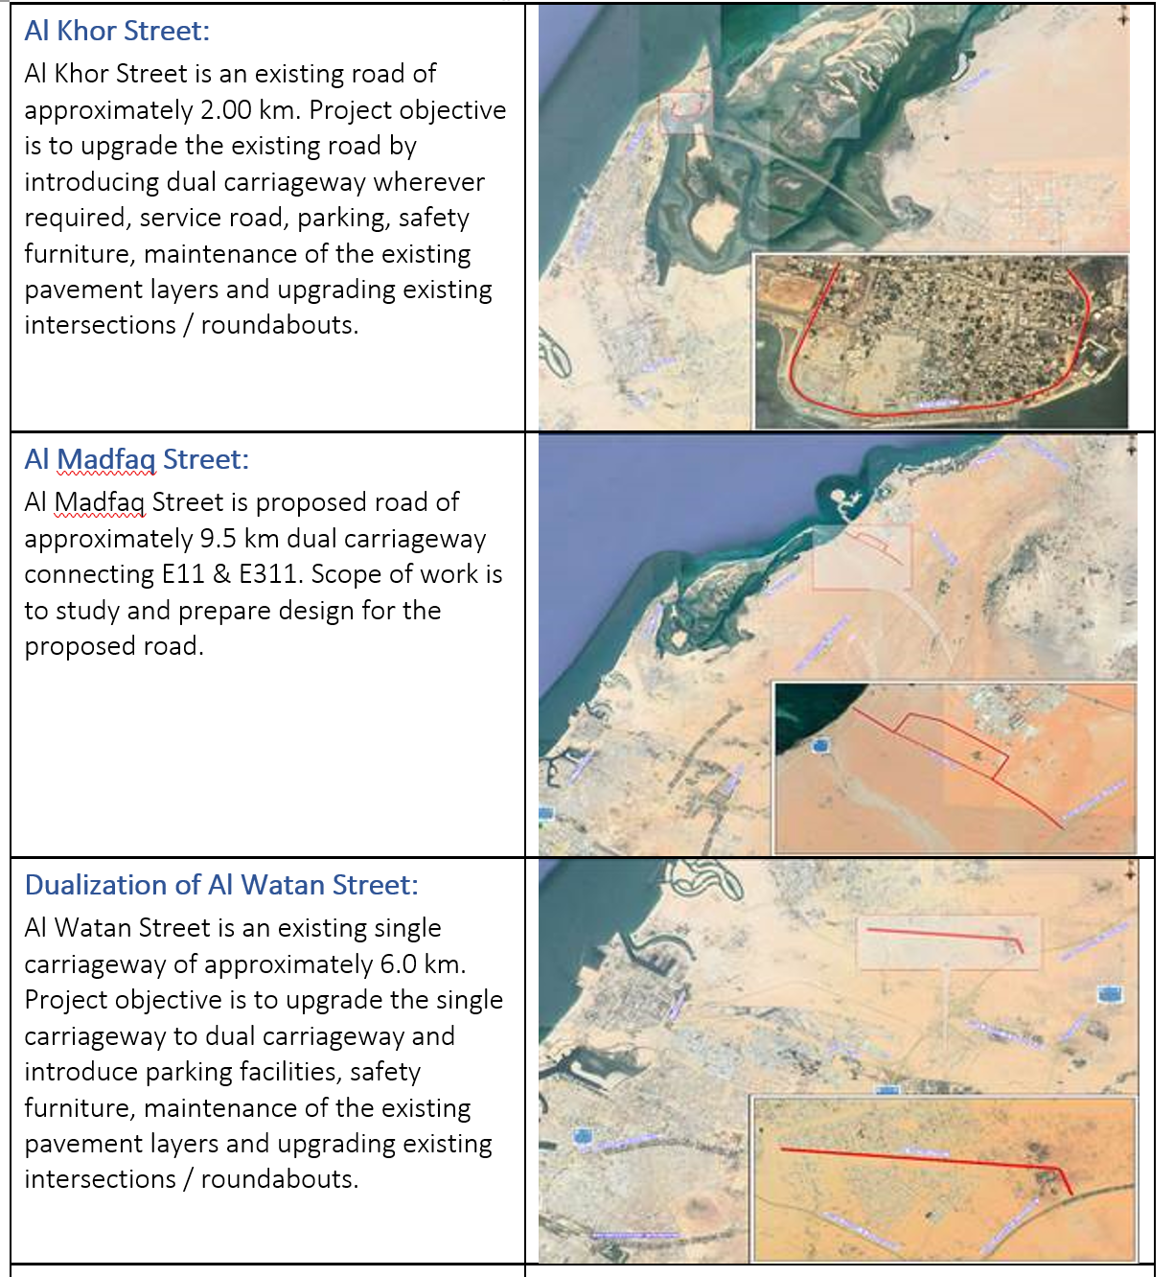
KEY PROJECTS - UAE
3 Roads In Umm- Al Quain (EIA-Hydrology Study- Pavement Design

Slide 20
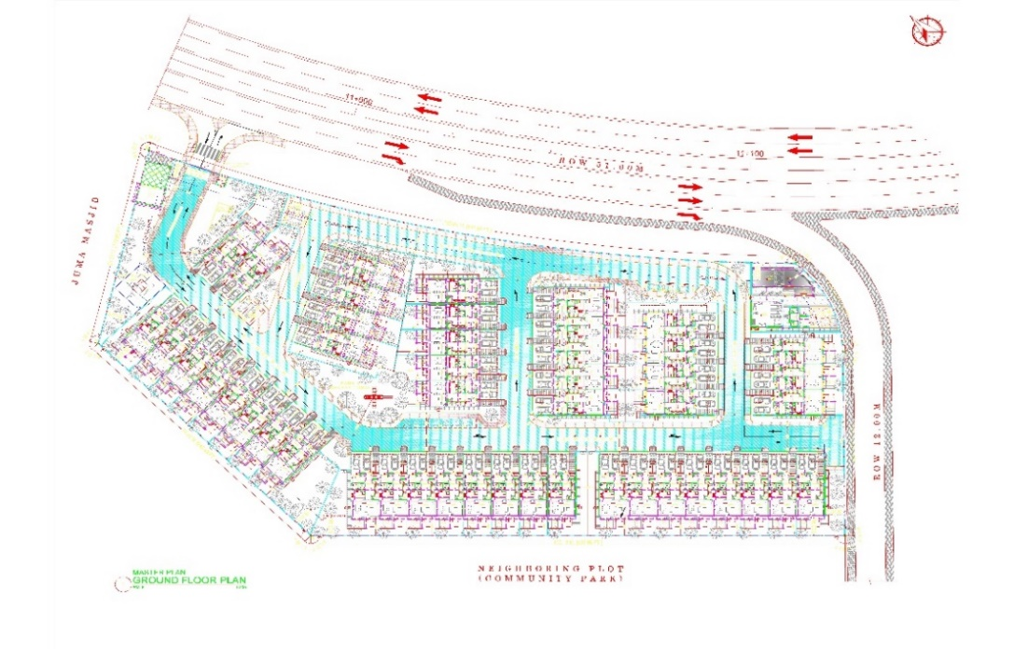
KEY PROJECTS - UAE
Project Name: 47 Villa Townhouse, Dubai, UAE.
Project Overview
47 Villa Townhouse is a vibrant community spanning over an area of 0.014 million sqm, having 47 elegantly designed townhouse villas.
Located in Plot No. 6727777
FASSIELA scope of work
Design of roads and fire network, water supply network, sewage network, stormwater network, electrical MV/LV networks, & irrigation network.
Fassiela Also prepared the shop
Drawings for construction

Slide 21
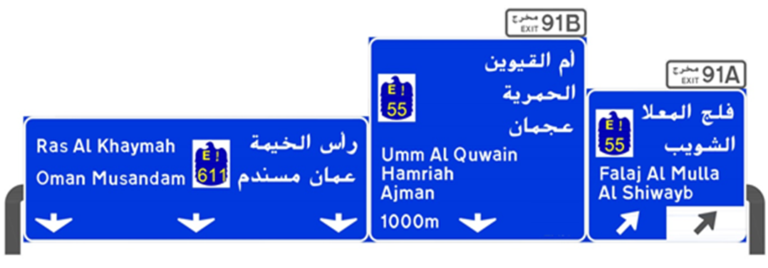
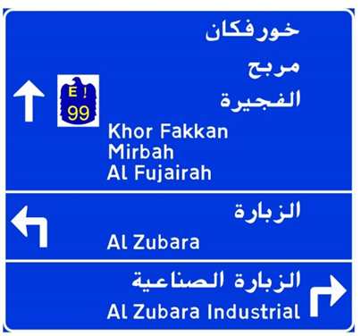
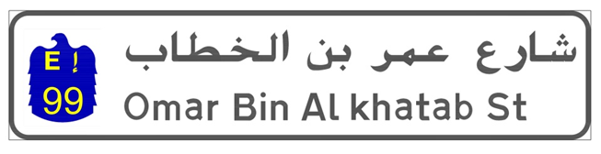
KEY PROJECTS - UAE
Project Name
Evaluation and Upgrade of Guide Signs on Federal Roads in Northern Emirates- UAE

Slide 22
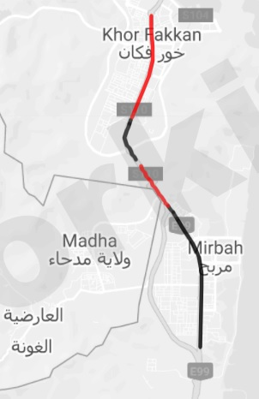
KEY PROJECTS - UAE
Project Name: iRAP road safety assessment for a pilot project for the Ministry of Energy & Infrastructure, UAE
Project Description : Road Safety assessment and road safety investment plan for a section of the E99 Road
Fassiela Scope of Work: Road Safety assessment and road safety investment plan

Slide 23
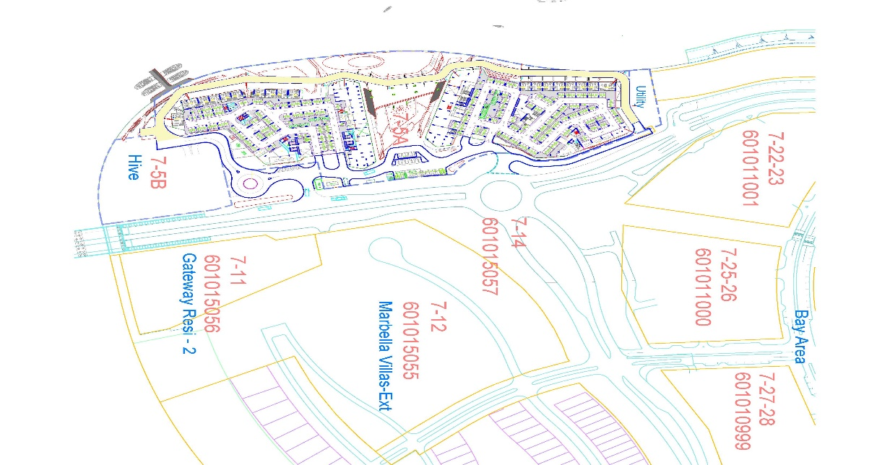
KEY PROJECTS - UAE
Project Name
Plot 7-5 Bay Area- Ras Al Khaimah, UAE
Project Overview
A mixed-use project spread over 0.033 million sqm area in Ras Al Khaimah, UAE, turning it into an ideal tourist destination for visitors and residents alike.
FASSIELA scope of work
Design of roads and fire network, water supply network, stormwater network, & irrigation network.

Slide 24
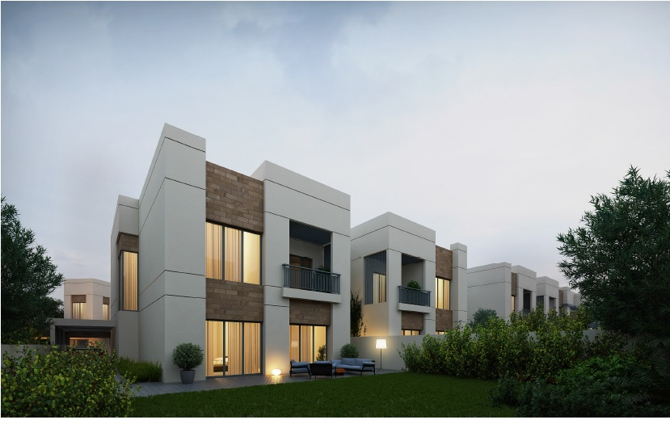
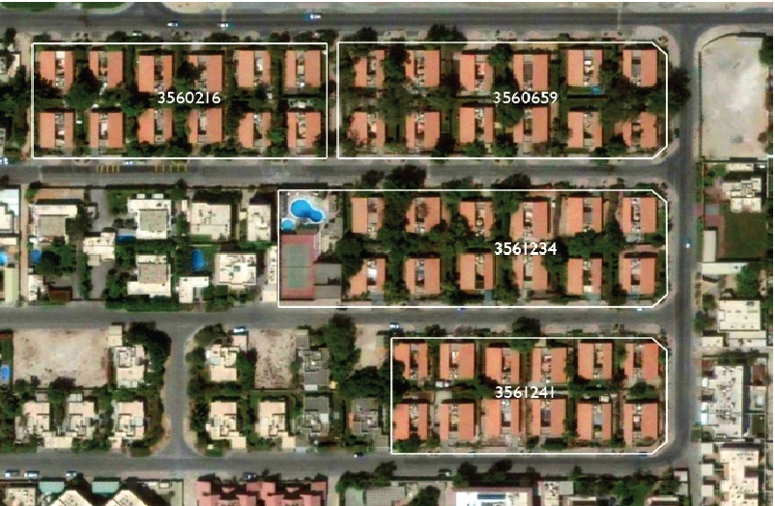
KEY PROJECTS - UAE
Project Name
Al Gurg Villas- Dubai, UAE
Project Overview
Demolition and reconstruction of 87 Villas for Al Gurg Foundation in 4 neighboring plots in Umm Suqaim, Dubai
FASSIELA scope of work
Design of Infrastructure Including: Adjustment to RTA Roads, Parking & Villa Entrances, Fire Network, Water Supply Network, Gas Network, Electrical MV/LV Networks

Slide 25
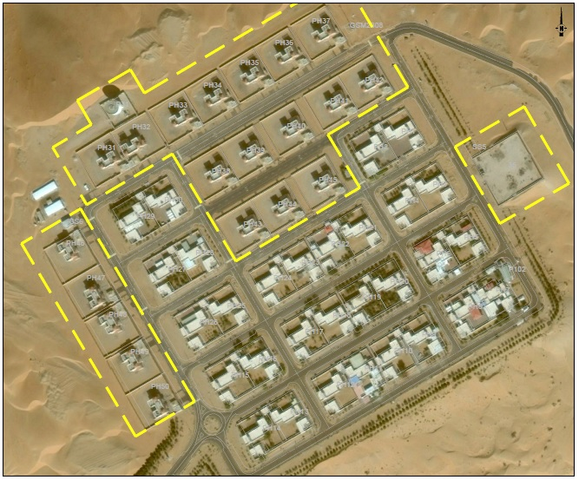
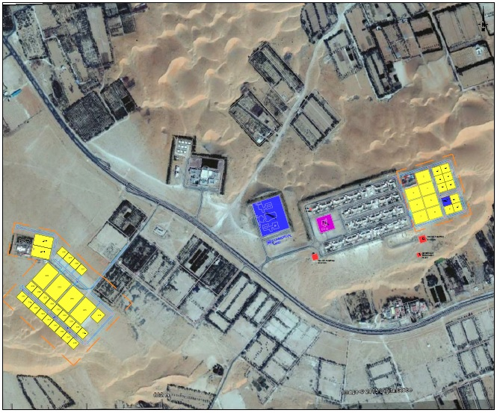
KEY PROJECTS - UAE
Project Name
LIWA- Housing, Western Region, Abu Dhabi
Project Overview
The development of multiple Plots in Liwa East and Liwa West in the Western Region of Abu Dhabi.
Roads Design

Slide 26
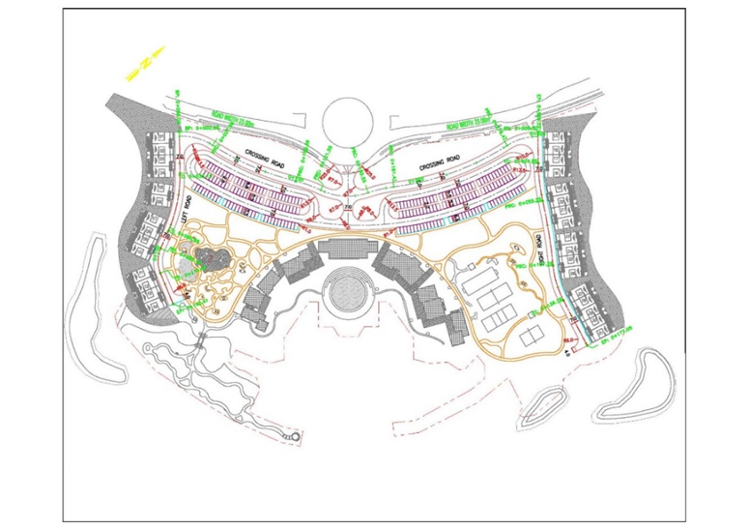
KEY PROJECTS - UAE
Project Name
Jumairah Island Lake Side, Packages 1 & 2
Project Overview
The project is planned to include 84 villas, recreational facilities and landscape
FASSIELA scope of work
The Complete roadway and Fire Network, Water Supply Network, Sewage Network, Strom Water Network, Electrical MV/LV Networks, &Irrigation Network

Slide 27
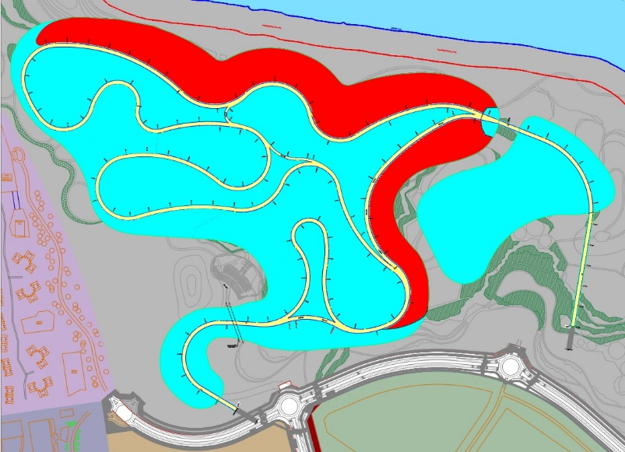
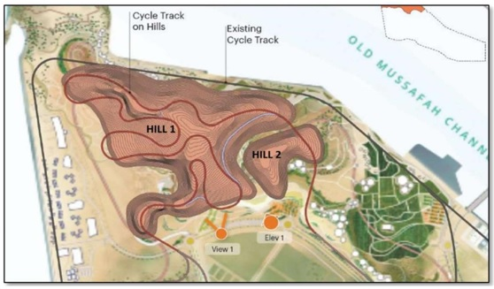
KEY PROJECTS - UAE
Project Name: Al Hudayriyat Island (West) - Biotopia Hills,
Abu Dhabi, UAE
Fassiela Scope of Work: Geotechnical Report, Review of Slope Stability

Slide 28
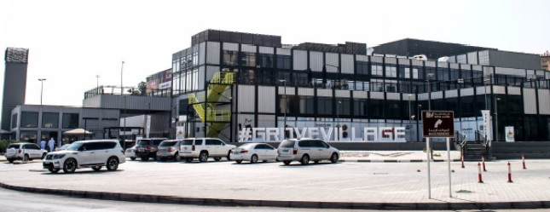
KEY PROJECTS - UAE
Project Name
Grove Mall- Ras Al Khaimah
Project Overview
Multiuse Mall
FASSIELA scope of work
Traffic & access study and design of parking setting out, grading, drainage and signing and road marking design- Including Approval from RAK Municipality.

Slide 29
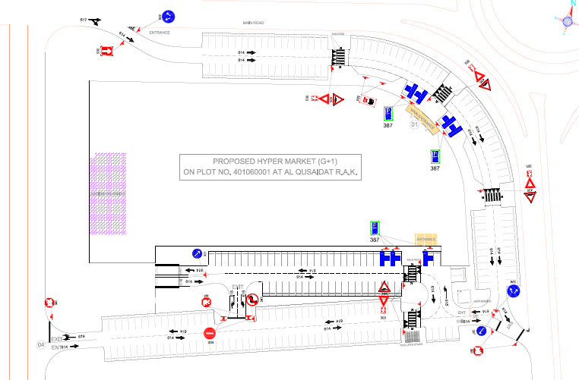
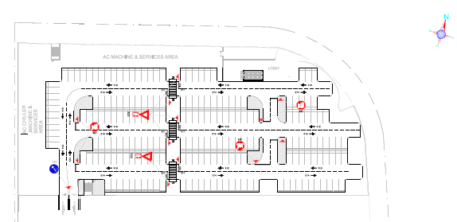
KEY PROJECTS - UAE
Project Name
NESTO Hypermarket- Ras Al Khaimah
Project Overview
Hypermarket for the famous NESTO chain of hypermarkets
FASSIELA scope of work
Traffic & access study and design of parking setting out, grading, drainage and signing and road marking design- Including Approval from RAK Municipality.
Dubai-UAE www.fassiela.ae

Slide 30
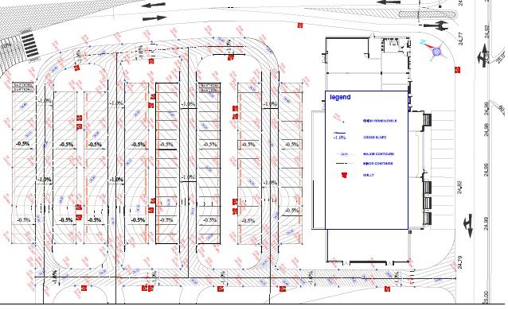
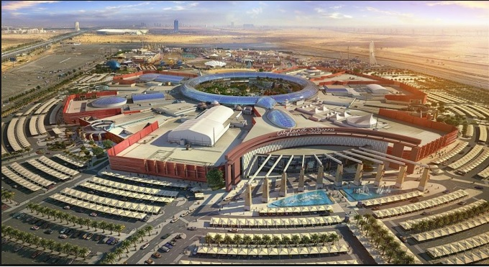
KEY PROJECTS - UAE
Project Name
City Land Mall- Dubai, UAE
Project Overview
An AED1.2 billion ($330 million) Mall known to be the world’s first “nature inspired” shopping destination, incorporating a 200,000 sq ft green central park area. Its retail capacity totals over 1.2 million sq ft of space accommodating over 350 retailers and F&B outlets.

Slide 31
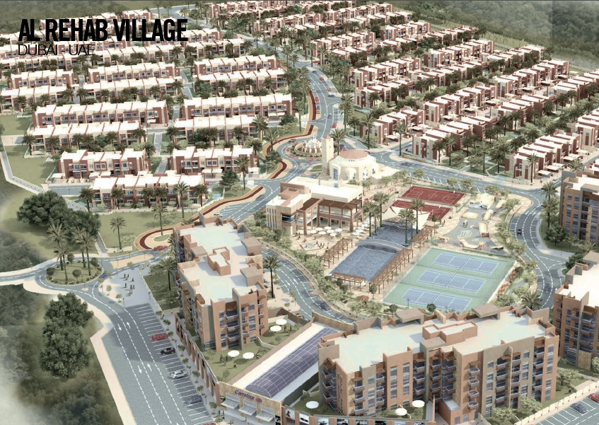
KEY PROJECTS - UAE
Project Name
Al Rehab Village, Dubai, UAE.
Project Overview
A mixed use development in Dubai Land, Dubai with a total area of 960,000 sq. ft including a vast green area, 4 residential buildings, 300 villas, health club, sports club, kid’s area, retail and mosque..
FASSIELA scope of work
Design of Infrastructure Including: Adjustment to RTA Roads, Parking & Villa Entrances, Fire Network, Water Supply Network, Gas Network, Electrical MV/LV Networks

Slide 32
Transportation UAE
Proposed Residential Building on Plot No, 3460672, Business Bay, Dubai UAE
Smart Parking Management System (PMS) Sites A and B total 57 locations in Dubai
Marina Shores Mixed Used Development on Plot No. 392-0601 at Marsa Dubai, Dubai UAE
Residential and Commercial Building on Plot No. 675-7734, Al Habiah Forth, Dubai, UAE
Residential and Commercial Building on Plot No. 647-7880, Wadi Al Safa 3, Dubai, UAE
Commercial Building on Plot No. 598-1261 Dubai Investment Park, Dubai, UAE
Commercial Building on Plot No. 382-0785 Al Sofouh Second, Dubai, UAE
DMS 148 994, Revised Access at Nad Al Sheba 3, Dubai, UAE
Chic Tower on Plot No. 346-0484 Business Bay, Dubai, UAE
Parking for Mosques, Schools and Paid Parking at 16 Locations at Different Locations, Dubai
GFH on Plot Number 646-1280 Wadi Al Safa 4, Dubai Land, Dubai, UAE
Residential Building on Plot Number A008 Dubai Creek Harbour, Dubai, UAE
Residential and Commercial Building on Plot No. 134-988, Al Mammzar, Dubai, UAE

Slide 33
EGYPT

Slide 34
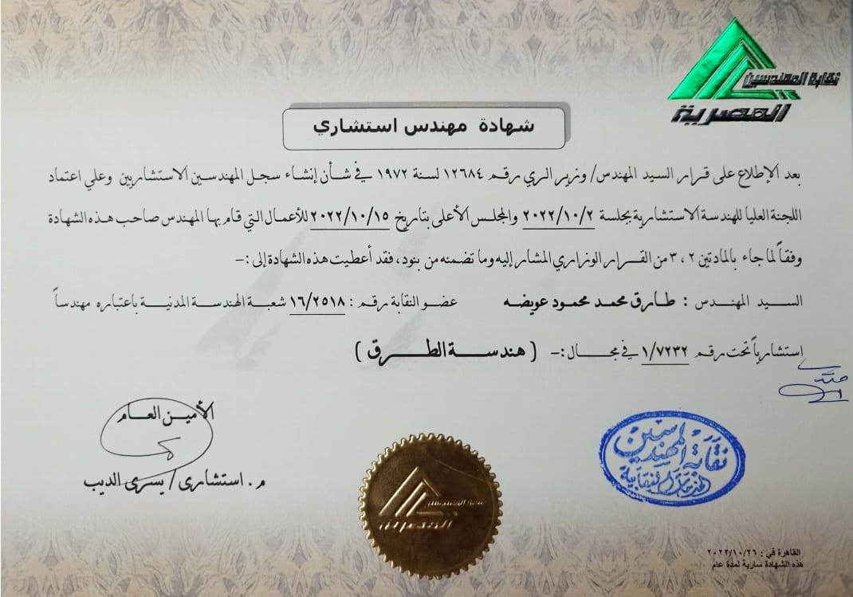
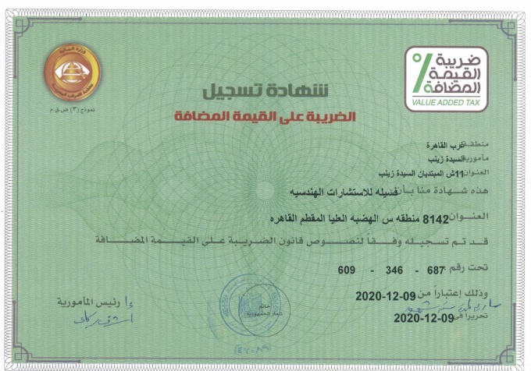
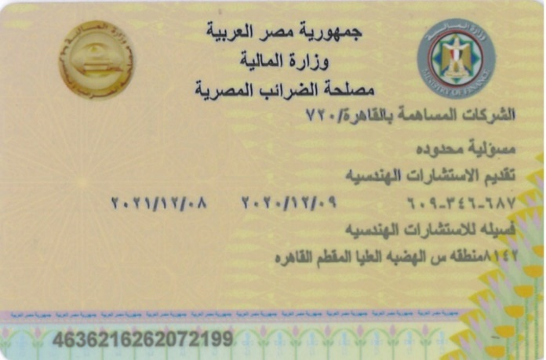
Egypt Registration

Slide 35
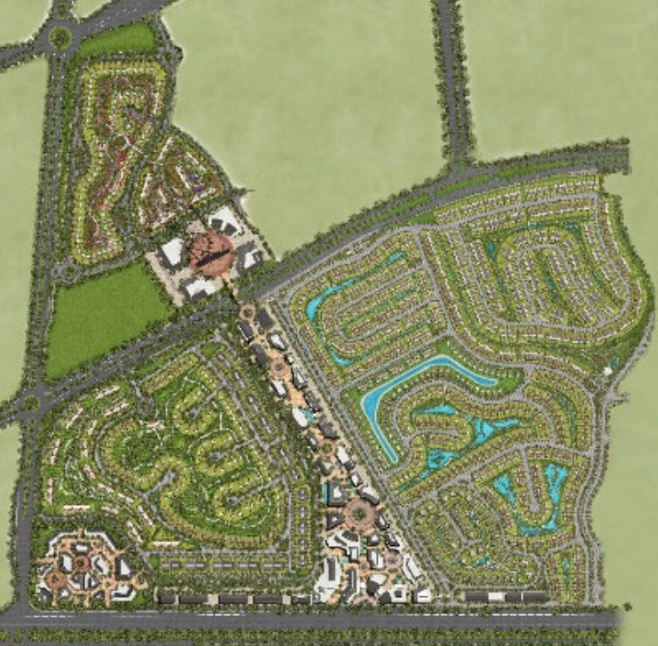
KEY PROJECTS - Egypt
Project Name
The MarQ– Mostkbal City, Egypt
Project Overview
Luxurious Residential compound located in Mostakbal City- New Cairo
Client: The MarQ Communities
FASSIELA scope of work
TIS & Design for All Infrastructure Networks

Slide 36
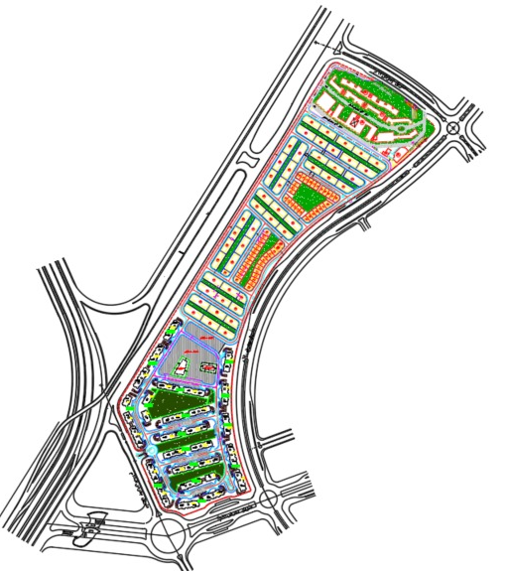
KEY PROJECTS - Egypt
Project Name
Aria– New Cairo, Egypt
Project Overview
Luxurious Residential compound located in Mostakbal City- New Cairo
Client: The MarQ Communities
FASSIELA scope of work
Design for All Infrastructure Networks

Slide 37
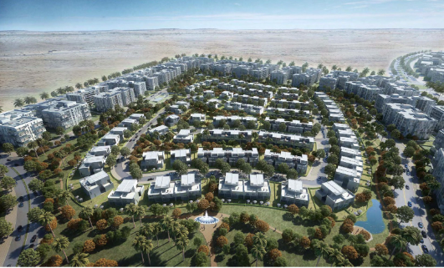
KEY PROJECTS - Egypt
Project Name
City of Oddysia – Cairo, Egypt
Project Overview
Luxurious Residential compound located in Mostakbal City- New Cairo
Client: Al Ahly Sabbour
FASSIELA scope of work
Design Review and Value Engineering for All Infrastructure Networks
Quantity takeoffs for All Infrastructure Works

Slide 38
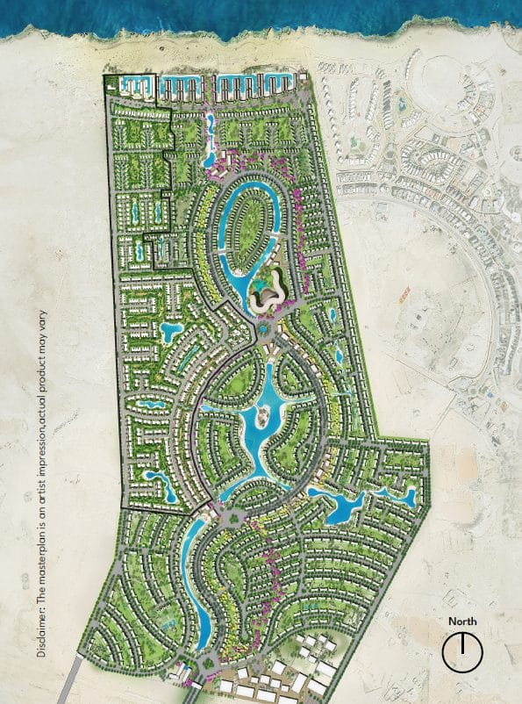
KEY PROJECTS - Egypt
Project Name: (summer)- Ras El-Hekma, Egypt
Project Description : A residential and commercial development of 3.496 million sqm in Ras El-Hekma city phase 1
Fassiela Scope of Work: Preparation of BODR for roads and fire network, water supply network, sewage network, stormwater network, electrical MV/LV networks, & irrigation network.

Slide 39
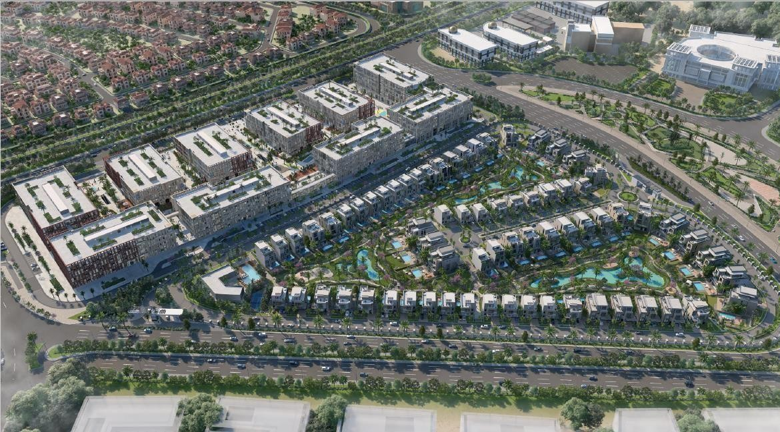
KEY PROJECTS - Egypt
Project Name: BP-04 (city edge)- New Cairo, Egypt
Project Description : A residential and commercial development of
0.16 million sqm in New Cairo
Fassiela Scope of Work: Design of roads and fire network, water supply network, sewage network, stormwater network, electrical MV/LV networks, & irrigation network.

Slide 40
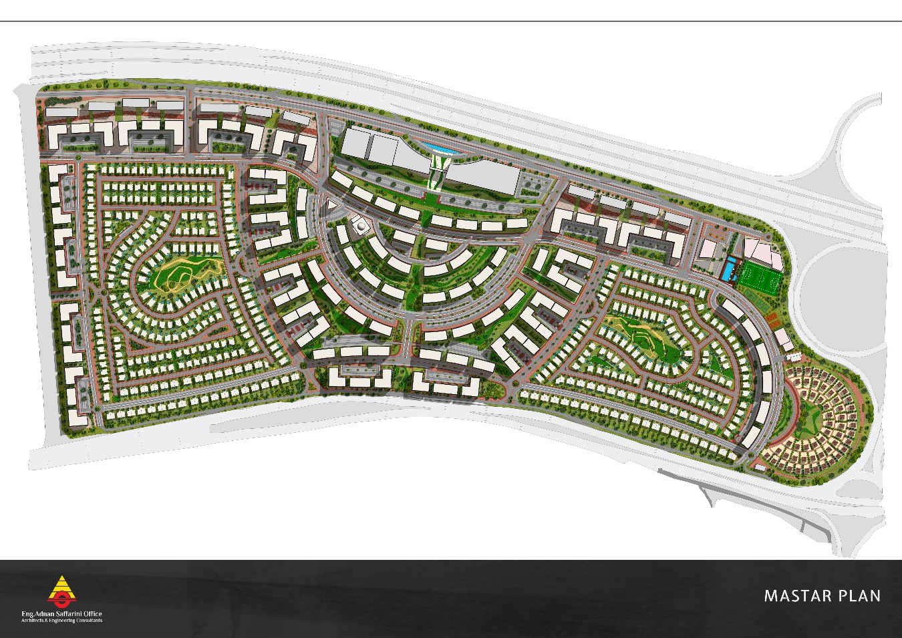
KEY PROJECTS - Egypt
Project Name: Sa’ada Development- Cairo-Suez Road Cairo Egypt
Project Description : A residential and commercial development of 1.5 million sq. Km in New Cairo
Fassiela Scope of Work: TIS- Design of Roads & Infrastructure

Slide 41
KEY PROJECTS - Egypt
Project Name
City of Oddysia – Cairo, Egypt
Project Overview
Luxurious Residential compound located in Mostakbal City- New Cairo
Client: Al Ahly Sabbour
FASSIELA scope of work
Design Review and Value Engineering for All Infrastructure Networks
Quantity takeoffs for All Infrastructure Works

Slide 42
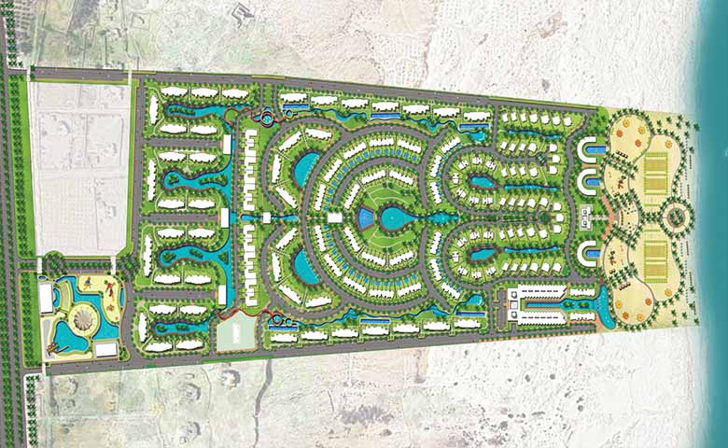
KEY PROJECTS - Egypt
Project Name
D.O.S.E – North Coast – Egypt
Project Overview
A residential compound with commercial and entertainment services with a total area of 527,000 m².
FASSIELA scope of work: TIS and design of roadwork

Slide 43
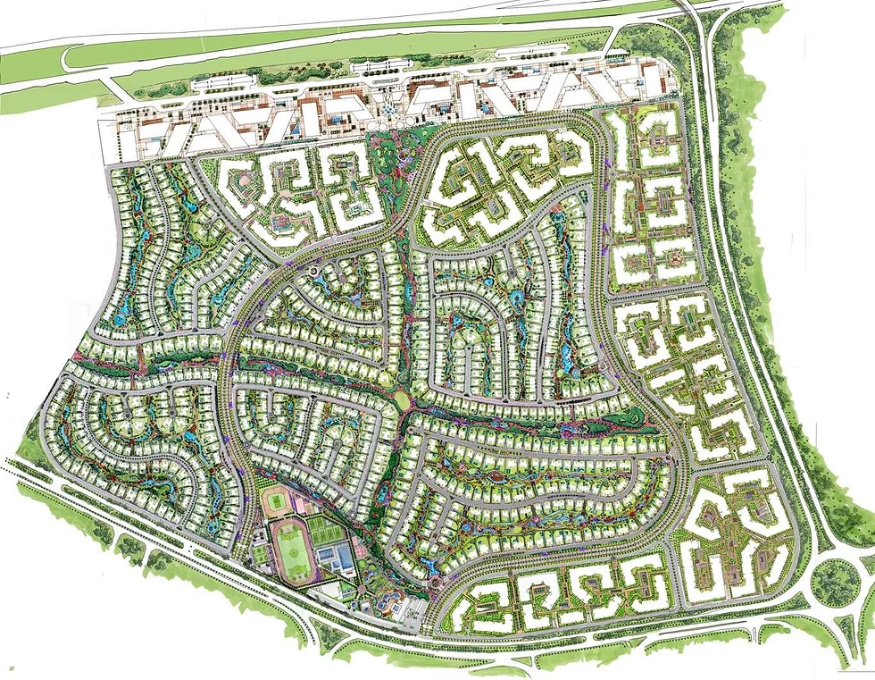
KEY PROJECTS - Egypt
Project Name
Swan Lake Residence – New Cairo – Egypt
Project Overview
A residential and commercial compound with a total area of 1,860,000 m².
FASSIELA scope of work
Review and adjustment of infrastructure Design
Roads & Infrastructure Shop Drawings.
BIM Modelling and Clash Detection

Slide 44
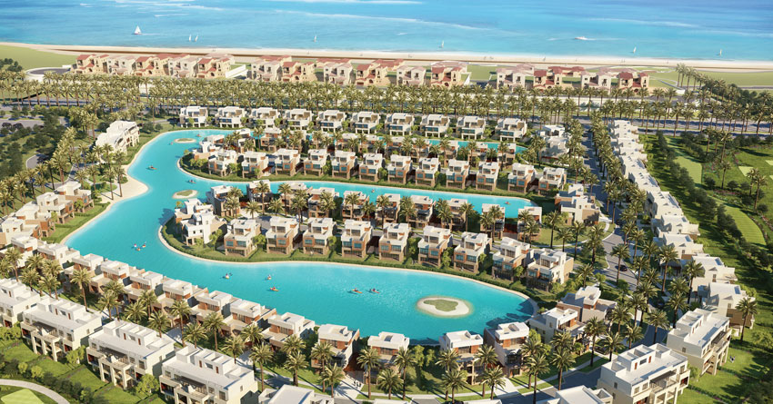
KEY PROJECTS - Egypt
Project Name
Marassi 171 P – North Coast – Egypt
Project Overview
A luxurious residential compound with an area of 160,000 m².
FASSIELA scope of work
Review and adjustment of infrastructure Design
Roads & Infrastructure Shop Drawings.
BIM Modelling & Clash Detection

Slide 45
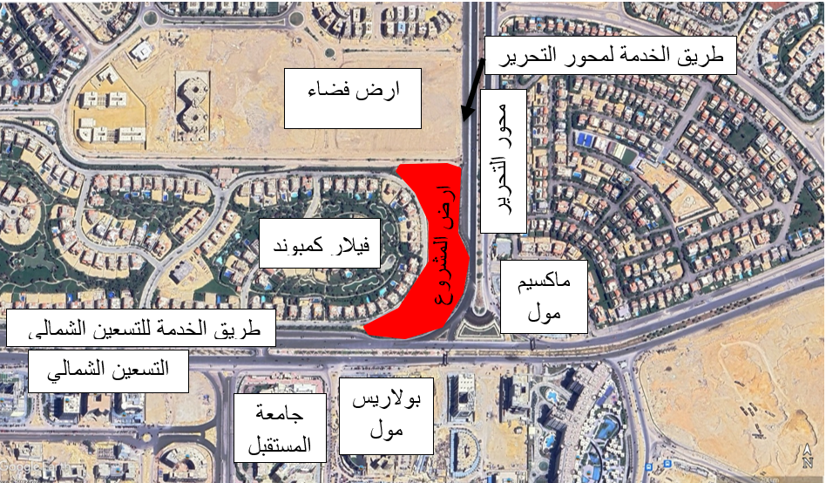
KEY PROJECTS - Egypt
Project Name: Villar Compound- New Cairo, Egypt
Project Description : A residential and commercial development New Cairo
Fassiela Scope of Work: TIS- for the Commercial District

Slide 46
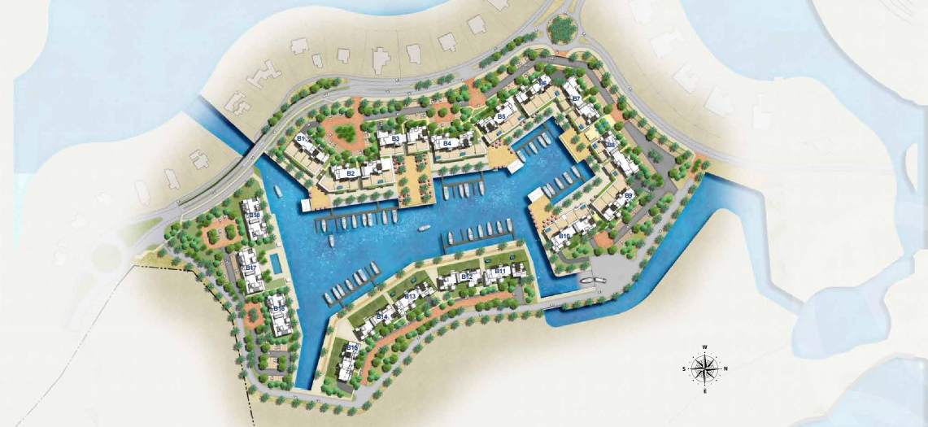
KEY PROJECTS - Egypt
Project Name
Fanadir Marina Resort – El Gouna – Egypt
Project Overview
A marina located on the shore of the Red Sea in El Gouna which extends over an area of 120,000 m².
FASSIELA scope of work
Roads Design for southern zone.

Slide 47
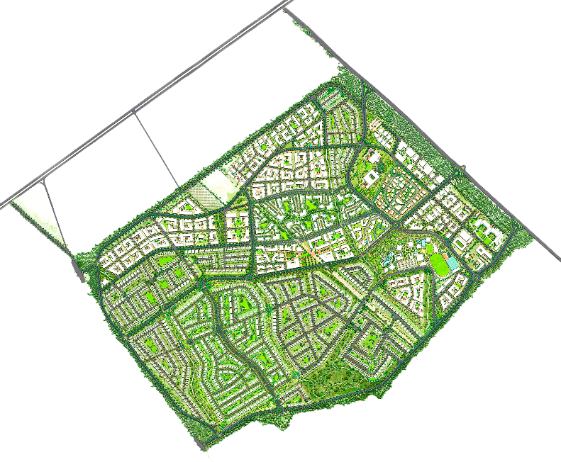
KEY PROJECTS - Egypt
Project Name
O West Compound – 6th of October – Egypt
Project Overview
A residential compound with several social services, schools and medical services.
FASSIELA scope of work:
TIS, Roads Design of a 127650 m² parcel .

Slide 48
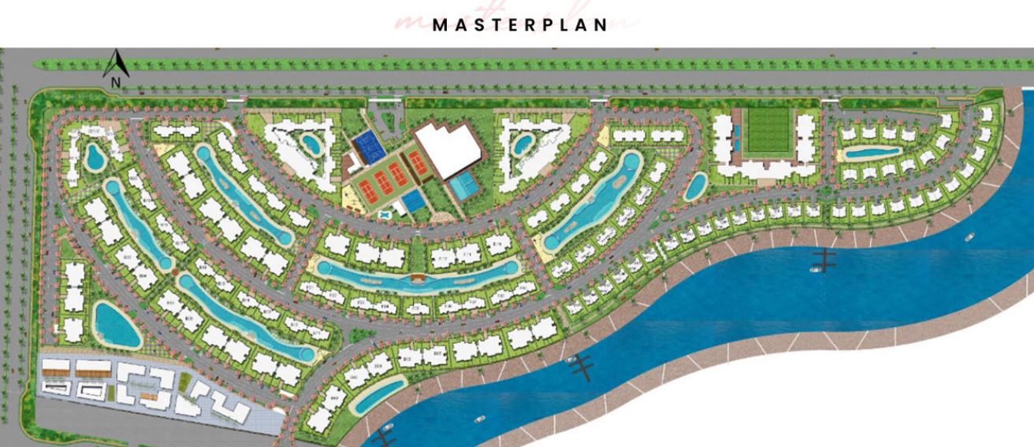
KEY PROJECTS - Egypt
Project Name
L’Hiver– New Alamein – Egypt
Project Overview
A luxury compound with 1000m length overlooking Alamein Lagoon.
FASSIELA scope of work
Traffic Impact Study & Roads Design.

Slide 49

KEY PROJECTS - Egypt
Project Name
Sixty Iconic Tower – New Administration Capital – Egypt
Project Overview
A 45-Story Tower that extends on an area of 7800 m² and provides residential, commercial and medical services in addition to hotel rooms and office spaces.
FASSIELA scope of work
Traffic Impact Study.

Slide 50

KEY PROJECTS - Egypt
Project Name
Transportation Center – New Administration Capital – Egypt
Project Overview
Surface & Basement structure build on Total area of 300,000 m2 to accommodate bus station & parking area for 1000 Bus in basement level moreover, a commercial & administration area with 5000 Car park
FASSIELA scope of work
Traffic impact study , Design for Surface car park , Basement Bus Park, Ramps, Access Entrances Service roads

Slide 51

KEY PROJECTS - Egypt
Project Name
Marabet Cairo - Egypt
Project Overview
Complete residential –commercial and horse-riding facility including Traffic - 31.5 Km road network and one tunnel under high-speed rail and design of one internal parcel .
FASSIELA scope of work
Road networks design

Slide 52
KEY PROJECTS - Egypt
Project Name: BP-04 (city edge)- New Cairo, Egypt
Project Description : A residential and commercial development of
0.16 million sqm in New Cairo
Fassiela Scope of Work: Value Engineering & redesign of Landscape (Hard scape, Soft scape , Submain Irrigation & Lakes).

Slide 53

KEY PROJECTS - Egypt
Project Name: Bianchi North Cost, Egypt
Project Description : A residential and commercial development of
420,000 sqm in New Cairo
Fassiela Scope of Work: MEP for all Buildings & club house- Lakes Design

Slide 54
KEY PROJECTS - Egypt
Project Name: Neyom Payramids
Project Description : Design Review & value Engineering for Building 8 & 9
Fassiela Scope of Work: Design Review & value Engineering for all MEP

Slide 55
KSA

Slide 56

KEY PROJECTS - KSA
Project Name
Makkah Fifth Ring Road, Makkah-KSA.
Project Overview
135 km of an Expressway Ring Road with 21 Proposed Interchanges
FASSIELA scope of work
Traffic Study inclusive of 2024 Model Calibration, Developing Ramadan Peak, AM & PM Peak models for the horizon year 2065, interchange options and interchange analysis for each option and selection of the best option

Slide 57

KEY PROJECTS - KSA
Project Name
Prince Abdullah Road, Diryiah, KSA
Project Overview
Road Upgrade In Diriyah to reflect the culture and heritage of Diriyah
FASSIELA scope of work
Traffic Signal Design, Hydrology Study, Stormwater Drainage, Streetlighting, Utility Corridor Allocation, BIM Modelling & Clash Analysis for all services.

Slide 58

KEY PROJECTS - KSA
Project Name : Noon Logistics Hub- Riyadh, KSA
Road design (Earthworks, geometric design, pavement design and signing & road marking for Noon logistics hub, KSA.

Slide 59
KEY PROJECTS - KSA
Project Name
Two Labor Camps- NEOM, KSA (5000 worker and 10,000 Worker)
FASSIELA scope of work
Design review of all infrastructure works for both camps

Slide 60

KEY PROJECTS - KSA
Project Name
Roads & Parking for Consultant’s Offices (Phase 2)- NEOM, KSA
Project Overview
Administrative Parking in The new city Of NEOM, KSA.
FASSIELA scope of work
Road Design (Earthworks, geometric design, pavement design and signing & road marking).

Slide 61

KEY PROJECTS - KSA
Project Name
Roads & Parking for Consultant’s Offices- NEOM, KSA
Road design (Earthworks, geometric design, pavement design and signing & road marking for NEOM consultant’s offices- NEOM, KSA.

Slide 62

KEY PROJECTS - KSA
Project Name
Al Marwa Project- Jeddah, KSA
Project Overview
Mixed Use Development
FASSIELA scope of work
Design of Roads and Fire Network, Water Supply Network, Sewage Network, Strom Water Network, Electrical MV/LV Networks, &Irrigation Network

Slide 63
Qatar

Slide 64

KEY PROJECTS - Qatar
Project Name
Modifications to G-Ring road Interchanges –Doha-Qatar
FASSIELA scope of work
TIS & Development of Concept Design for proposed roads along G-Ring Road including adding one table top
interchange and modifications to
two interchanges in addition to
design of three signalized junctions along the Eastern Road east of Barwa Integrated Family Housing as part of the TIS requirement

Slide 65

KEY PROJECTS - Qatar
Project Name: RAS LAFFAN PORT CONTROL TOWER. Qatar
Fassiela Scope of Work: Review of Earthworks Specifications

Slide 66

KEY PROJECTS - Qatar
Project Name
Barwa Integrated Family Housing
Complete Traffic Impact Study (TIS, Design of Roads networks for Barwa Integrated Family Housing in Doha-Qatar, more than 1 million sq.m Including arterial and local roads and 3 signalized junctions

Slide 67

KEY PROJECTS - Qatar
Project Name
Barwa Labor Accommodation
Complete Traffic Impact Study (TIS, Design of Roads networks for Barwa Labor Accommodation in Doha-Qatar, More than 1 million sq.m Including arterial and local roads.

Slide 68

KEY PROJECTS - Qatar
Project Name
Metro Green Line access road to Main Logistics and Production Area (MLPA)
Project Overview
The Doha Metro Green Line is currently under construction It is required to build a road that connects the under construction alignment and stations to the MLPA site to be used by haul trucks to dump the massive earthwork volumes extracted from the stations in the dump area included within the site.
Scope of work
Complete geometric options for the road corridor, geometric and pavement design of the selected corridor.

Slide 69
Africa

Slide 70

KEY PROJECTS - Somalia
Project Name: Pearl Beach- Mogadishu, Somalia
Project Description : 1 million sq.m. proposed mixed-use development providing employment, shopping, schools, places of worship, recreation and hotels within its overall vision.
Fassiela Scope of Work: Design of roads and fire network, water supply network, sewage network, stormwater network, electrical MV/LV networks, & irrigation network.

Slide 71
KEY PROJECTS- Kenya
Project Name: Creekside Garden City- Mombasa, Kenya
Project Description : 200,000 sq.m. mixed-use development providing employment, shopping, schools, places of worship, recreation and hotels within its overall vision.
Fassiela Scope of Work: Design of roads and fire network, water supply network, sewage network, stormwater network, electrical MV/LV networks, & irrigation network.

Slide 72

KEY PROJECTS- Zanzibar
Project Name
Mkoani Sea Port – Mkoani – Zanzibar
Project Overview
A causeway on the port of Mkoani city in addition to a container yard next to the port.
FASSIELA scope of work
Roads and Infrastructure Design.

Slide 73


KEY PROJECTS- Libya
Project Name
Benghazi Airport Road Upgrade, Benghazi, Libya.
Project Overview
Highway Road connecting the city of Benghazi and the Benghazi Airport.
FASSIELA scope of work
TIS & Highway Design foe Upgrading the highway road and adding several underpasses, tunnels and bridges for better circulation.

Slide 74
MEP Projects
In 2023 Fassiela Acquired KEp (Khaled Eweida & Partners, Previously Crown Home Consultants). A Company with over 30 years of experience in MEP services in the Middle East

Slide 75
KEY PROJECTS - MEP
Luxury Hotels and Resorts
-Al Faysalia Rosewood-Riyadh, KSA.
-Jeddah Airport Holiday Inn-Jeddah, KSA
-Yanbu Hilton Harbor Hotel-Yanbu, KSA.
-Jeddah Meridian-Jeddah, KSA.
-Makkah Marriott-Makkah, KSA.
-Maritim Hilton-Alexandria, Egypt.
-Marina Way Lagoon Beach Hotel and Resort-North Coast, Egypt.
-Bianchi Beach Resort-North Coast Egypt.
-Sheraton Hotel and Resort-Sharm Alsheikh, Egypt.
-Hyatt Regency Hotel and Resort-Sharm Alsheikh, Egypt.
-Sonesta Hotel-Sharm Alsheikh, Egypt.
-Intercontinental Hotel-Hurghada, Egypt.
-Radisson Blu Hotel-Cairo, Egypt.
-Ras Elbar City Hotel-Ras Elbar, Egypt.
Pharma Plants
-Pharmapack- Six of October City, Egypt.
-Swiss Pharma-Six of October City, Egypt.
-Trinity Global Factory-Ethiopia.
Hospitals
-AlMaghrabi Eye Hospital-Cameroon.
-Soliman AlHabib Hospital-Riyadh, KSA.
-Renovation of Kaser AlAini Hospital-Cairo, Egypt.
-Electrical Syndicate Hospital-Cairo, Egypt.

Slide 76
KEY PROJECTS - MEP
Residential and Commercial Projects
-QAFAC Head Office-Doha, Qatar.
-Al Wakra Office Building-Qatar.
-Al Ashraf Commercial and Residential Tower-Jeddah, KSA.
-Zaki Farsi Residential and Commercial Tower-Jeddah, KSA.
-Madina International Market-Madina, KSA.
-The Fish Market-Jeddah, KSA.
-YARU Residential and Commercial Complex-Cairo, Egypt.
-Sarai Mall-Cairo, Egypt.
-Mirage Mall-Cairo, Egypt.
-Katameya Heights-Cairo, Egypt.
-Katameya Dunes-Cairo, Egypt.
-Oriental Wavers Head Quarters-Cairo, Egypt.
-Lafarge Cement Headquarters-Cairo, Egypt.
Banks
-HSBC Bank Headquarters-Cairo, Egypt.
-Piraeus Bank Headquarters-Cairo, Egypt.
-CIB Bank Headquarters-Cairo-Egypt.
Factories
-Halwani Brothers Factory-Cairo, Egypt.
-Lonkia Frozen Fries Factory-Cairo, Egypt.
-Almaraai Cradle Milk Factory-Jeddah, KSA.

Slide 77
Fassiela’s Policies & Procedures
Quality Policy
Our Quality Policy is “Do The Job Right The First Time”
Outline of Design Quality Procedures
At suitable stages, systematic reviews of design are performed in accordance with project requirements, departmental procedures, and Quality procedures for the following reasons:
a) Evaluation of the design against client’s requirements, goals and objectives.
b) Identification of any coordination problems and propose necessary actions.
Design Verification
Verification is performed in accordance with project requirements and the appropriate departmental and/or Quality procedures to ensure that the design and development outputs have met the design and development input requirements. Records of the results of the verification and any necessary actions are maintained.

Slide 78
Design Validation
Design validation is performed, as necessary, to ensure that the resulting product and/or service is capable of meeting the requirements for the specified application or intended use, where known. Wherever practicable, validation is completed prior to the delivery or implementation of the product and/or service.
Records of the results of validation and any necessary actions are maintained.
Control of Design Changes
Design changes are identified, and records maintained. The changes are reviewed, verified, and validated, as appropriate, and approved before implementation. The review of design and development changes includes evaluation of the effect of the changes on interfacing disciplines and products and/or services already delivered.
Records of the results of the review of changes and any necessary actions are maintained.

Slide 79


Brief About our Founder :
Eng. Tarek Eweida
Managing Director
Tarek Eweida, Bsc, MBA, PMP, STP is an Experienced Head with a demonstrated history of working in the civil engineering industry. Tarek Eweida was at Senior Management level in International Companies Such as: Parsons & Louis Berger.
Tarek Eweida holds a BSc. In Civil Engineering from Cairo University, an MBA from the University of Cumbria-UK, a Project Management Professional (PMP) accreditation from PMI, USA, an Orange Badge Sustainable Transportation Professional (STP) accreditation from the Greenroads Foundation, USA and an iRAP Accredited Supplier
Brief About our GM :
Eng. Amr A. Hemade
Throughout 27 years of experience in the infrastructure design and construction field, Amr was involved with International Companies Such as: Parsons, GHD, AECOM, EMAAR, MIDMAC, Yuksel, Vinci, Archirodon Group & the USD AID program. Amr holds a BSc. In Civil Engineering from Cairo University

Slide 80

iRAP

Slide 81


Tarek Eweida is the
only accredited Sustainable
Transportation Professional (STP) in Egypt by Green roads Association, USA
https://www.greenroads.org/stpdirectory

Slide 82

DM - Roads

Slide 83

DM – PM FS

Slide 84
Our Mission:
We offer high quality engineering services with unbeatable costs. We strive to convince our clients to add to their projects element of Sustainability and BIM engineering.
Our Vision:
Is to reach a point were at least 75% of our projects have Sustainability at the center of their goals, go beyond Engineering Consultancy and have Sustainability as a daily lifestyle and have a reach out to influence all human beings, all species, the environment and the entire planet
Our Goal :
Is always stand in line with our clients needs, meet their expectations, reduce their financial obligations & offer them state of art engineering solutions. by the adoption of designs, specs and construction methods that were intended to reduce the cost to suit the Egyptian market needs, without losing the international flavor.
Address
1002 Park Avenue Tower P.O. Box: 455047 Dubai – UAE
Mohammed Al Makreef St. 1st Floor , Flat No. 2 Nasr City , Cairo ,
Web site: www.fassiela.ae email: support@fasseila.com

Slide 85
Our Directors :
Eng. Tarek Eweida (Transportation)
Eng. Amr A. Hemade (infrastructure & Supervision)
Eng. Khaled Eweida (MEP)
Our Team Leaders
Eng. Omar Ftooh (Transportation Team leader)
Eng. Rasha Hussein (Wet utilities)
Eng. Ahmed Farag (Dry Utilities)
Mr. Sherif Abd Sadek (B.D / Admin Manager)

Slide 86
Contact us
Eng. Tarek Eweida:
Mobile UAE : +971 52 612 65 86
Mobile Egypt : +20 10 661 692 02
Email : tarekeweida@fassiela.com
Eng. Amr A. Hemade:
Mobile Egypt : +20 12 867 66 66 1
Email : amrhemade@fassiela.com
Address :
1002 Park Avenue Tower, Tel.: 04 325 7061, P.O. Box: 455047 Dubai – UAE
Mohammed Al Makreef St. 1st Floor , Flat No. 2 Nasr City , Cairo , Egypt.
Web site: www.fassiela.com
email: Info@fasseila.com

